Slide 1
Ways to Recruit and Retain Membership in Local Chapters
2022

Slide 2
Presentation to: GSRA
October 3, 2022
2

Slide 3
Recruiting & Retaining Members
By Jeanie Coffey
Vice President, Association Relations
3

Slide 4
Georgia County Territories
Dade
Catoosa
Whitfield
Fannin
Union
Towns
Rabun
Walker
Murray
Gilmer
White
Lumpkin
Habersham
Stephens
Chattooga
Gordon
Pickens
Stephens
Bartow
Dawson
Hall
Banks
Franklin
Hart
Floyd
Cherokee
Forsyth
Polk
Jackson
Madison
Elbert
Haralson
Paulding
Cobb
Gwinnett
Barrow
Clarke
DeKalb
Walton
Oconee
Oglethorpe
Wilkes
Lincoln
Douglas
Fulton
Rockdale
Greene
Carroll
Clay-
ton
Newton
Morgan
Taliaferro
McDuffie
Columbia
Heard
Coweta
Fayette
Henry
Putnam
Warren
Richmond
Spalding
Butts
Jasper
Hancock
Glascock
Troup
Meriwether
Pike
Lamar
Jones
Baldwin
Jefferson
Burke
Upson
Monroe
Washington
Harris
Talbot
Crawford
Bibb
Wilkinson
Johnson
Jenkins
Screven
Twiggs
Emanuel
Muscogee
Taylor
Peach
Bleckley
Laurens
Chattahoochee
Marion
Macon
Houston
Treutlen
Candler
Bulloch
Effingham
Eric Cannon
Schley
Pulaski
Alexander Williams
Stewart
Dooly
Dodge
Wheeler
Montgomery
Toombs
Evans
Bryan
Webster
Sumter
Crisp
Wilcox
Tattnall
Chatham
Quitman
Telfair
Liberty
Randolph
Terrell
Lee
Turner
Ben Hill
Jeff Davis
Appling
Long
Clay
Calhoun
Dougherty
Worth
Irwin
Coffee
Bacon
Wayne
McIntosh
Early
Baker
Tift
Pierce
Mitchell
Colquitt
Berrien
Atkinson
Glynn
Miller
Cook
Ware
Brantley
Seminole
Lanier
Clinch
Camden
Decatur
Grady
Thomas
Brooks
Lowndes
Charlton
Echols
Last update 9/1/22

Slide 5
AMBA Office Locations
450+ Associations 300k+ Customers 2 Million association members 44 Million prospects 700+ Employees 300+ Field agents
Strong growth history
Unique business model
Eugene
Harrisburg
Urbandale
Phoenix
Austin

Slide 6
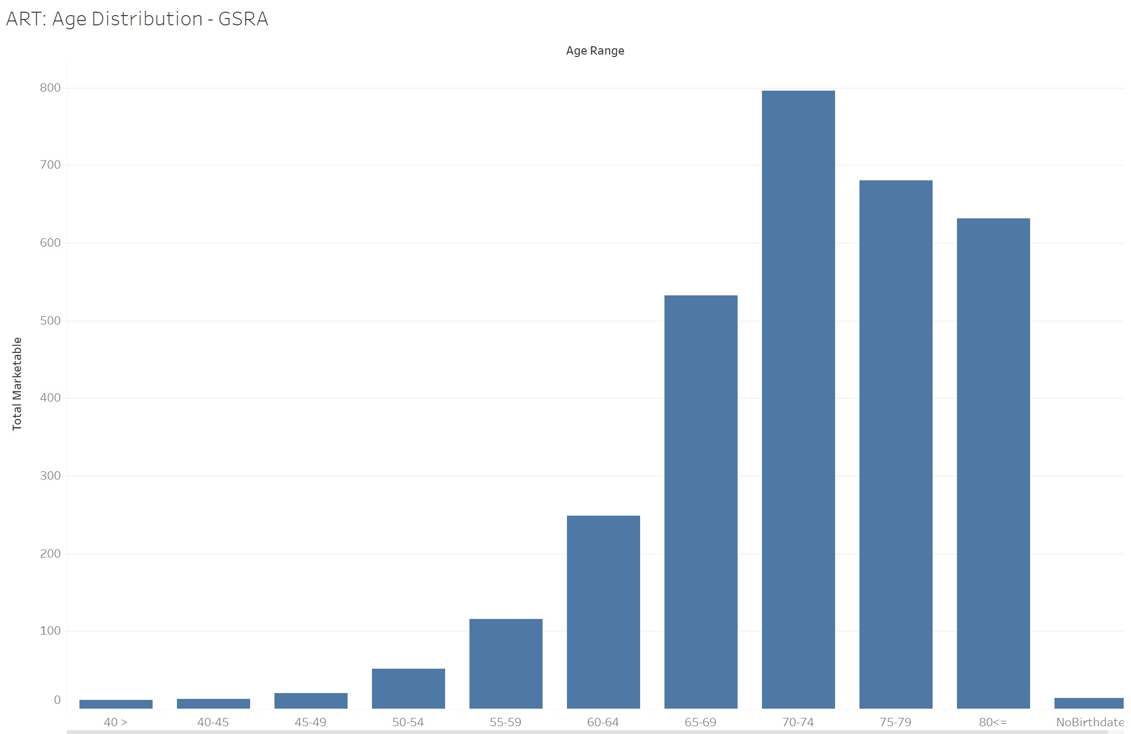
80+
75-79
70-74
65-69
60-64

Slide 7
Consider the 5 C’s
1.Change
5. Community
2. Millennials
3. Concerns
4. Communication
6
Notes:
#1 Circle-Change—no additions
#2Millennials-New and Younger Members for the Future add diversity and they are looking for information and leadership about the future.
#3 Concerns-Pension Protection concerns over retiree reduction in annual pension from their Retirement System, and also reduction in their pension’s Health Care plans. Changes in Social Security benefits in the future are also concern for the future
#4 Communication-Communication with their members is moving away from paper and more towards emails, all social media, and their website presents. Weekly or frequent communication with their members is needed.
#5 Community-Retirees want information on Legislative initiatives affecting them, advocacy, and updates. They want to hear from their Local and State Board of Directors and leaders on state and local happenings.

Slide 8
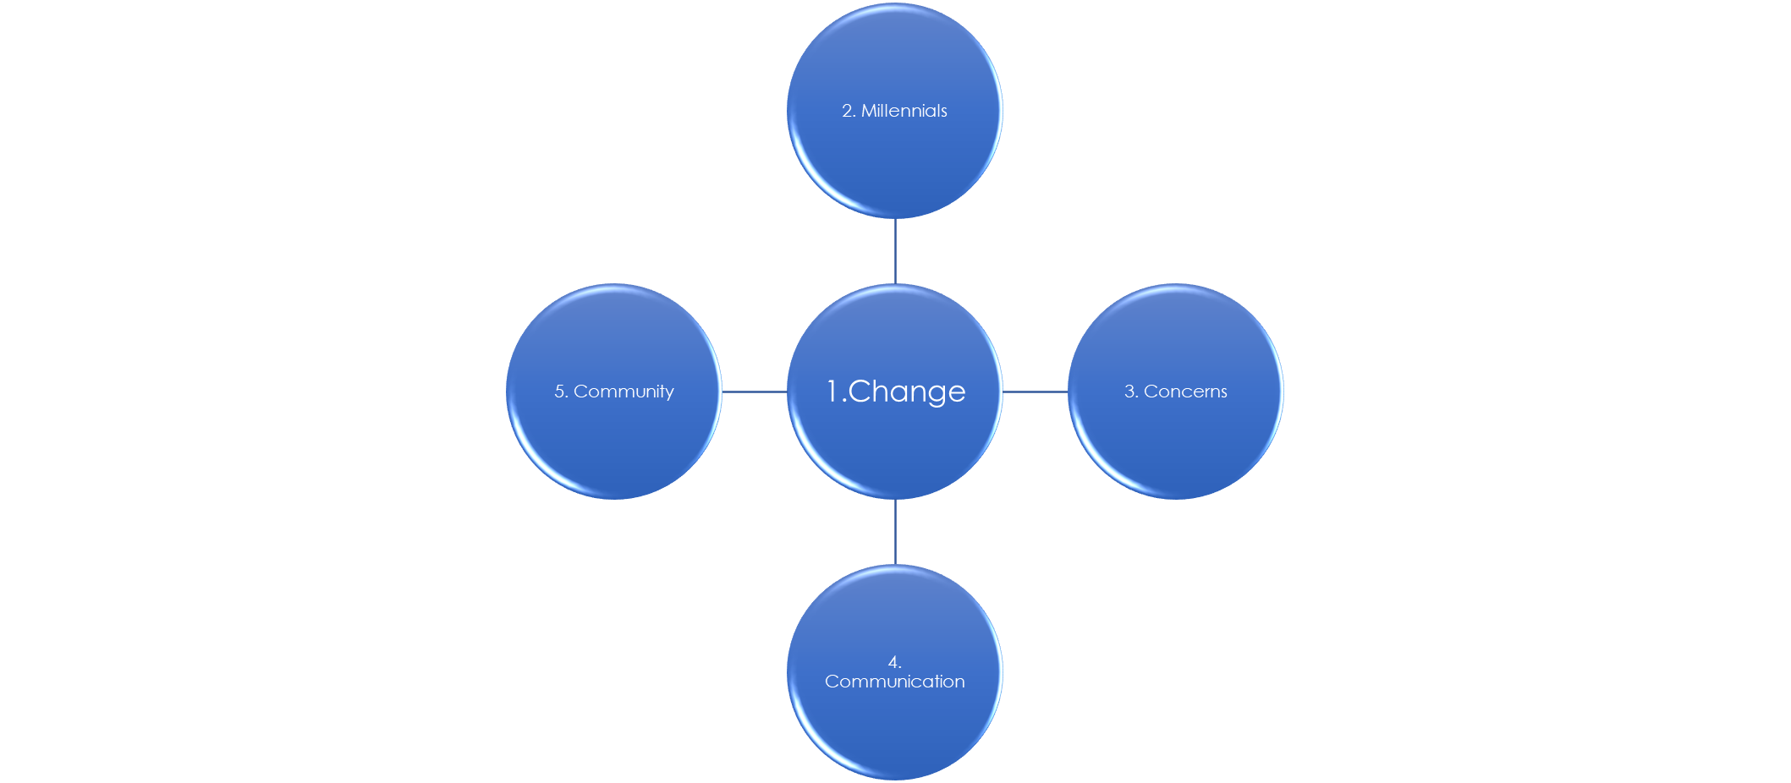
#1. Change
Change is inevitable or go the way of the dinosaurs.
The times they are a changing’
- Bob Dylan
1 | Change
7

Slide 9
Know Your Membership (and future membership)
In 2022, millennials will be the largest segment of workforce with close to 86 million people.
Baby Boomers
Born (1946-1964)
Generation X
Born (1965-1975)
Generation Y or Millennials
Born after early 1975 to early 2000s
1 | Change
8
Notes:
In 2022, millennials became the largest segment of the workforce with close to 86 million millennials to make up more than 50% of the workforce. By 2030 they will make up 75% of the workforce. Attracting younger members to your local and state meetings in important. They need to be educated on your cause and what they can do to help make positive changes needed in the future.

Slide 10
CHARACTERISTICS OF YOUNGER MEMBERS
Most educated generation
Social media only way to communicate
Live to work because no retirement plan in sight
Likes praise and short tasks
Family-oriented and cause-driven
3 | Communication
11
Notes:
Employees are retiring at a younger age. Many work 40 hours a week and also have a GIG job, or part time job on the weekends or after work to make more money, because of interesting work, or learn more, or to help others in the community.
Millennials work to Live NOT Live to Work. Family time is important to them. Their priorities differ from Baby Boomers who worked 30+ years at the same company and then retired.
88% like collaborative work rather than competitive work. They are not lazy, but want to work smarter and use technology.
They want a flexible schedule like a 4 day, 10 hour a day week, fair pay, technology needed and kept up to date. They want an inclusive workplace with all types of people and cultures young and old with different ethnic groups and inclusivity and all kinds of people.
96% say that community involvement is important and 80% say they donate to charity or non-profit organizations in their community. With your association involvement in community projects, they will join you and get involved in your association.
Your Local Chapter and State Associations should consider any age member who supports your cause. With the number of employees quitting their job before they stay 20 or 30 years working for the state what will attract them to your cause? And retain them? That is the question everyone is asking now.
If your cause is for legislative advocacy to protect your retirement system and healthcare program, then state employees of any age would want to support you. IF you are involved in charitable causes in the community, the will support you. Just let them know about all the things your local chapter does for the community and they will join.

Slide 12
#3. Concerns
With the cost of living escalating, retirees on a fixed income are worried
Health Care Cost
Retirement
Define Benefit
Define Contribution
Hybrid Benefit
Social Security
WORRY
Budget
2 | Concerns
9

Slide 13
#4. Communication
“
We must look at the way we communicate with our members.
“
We have to change with the times in order to be more effective
3 | Communication
Notes:
Social Media via FaceBook, TicTock, Podcasts, Email, website, Blogs, twitter, zoom calls, are all preferred ways to communicate with members, non-members, especially younger members.
Use email and text message to contact and publicize to your members and potential members upcoming meetings and activities. Many associations have weekly or monthly emails concerning Legislative Updates that are very popular and timely with their members. Some still have a telephone tree format for the few that need it.
Keep your website up to date with the latest state information and list of state and local unit officers and Board meeting calendar. Some associations have Local Unit pages with officers, calendar, and activities for the month.
Publicize all your community volunteer involvement activities so the community know you exist and all the thinks you do in your association for the community.
State agencies and offices in your Local Unit area, take a Poster for the wall in the break room and Local Unit flyers with location and dates of your meeting places for the month. Include information on legislative updates and upcoming community activities.
Quarterly have fun family events to attend at local museums, ball parks, music venues, parks, historical places, bus trips or interesting places that your group would enjoy.
Create a State Men’s Coffee Club for past and present employees who worked in State Agencies. This way you may get more men to join your association and participate.

Slide 14
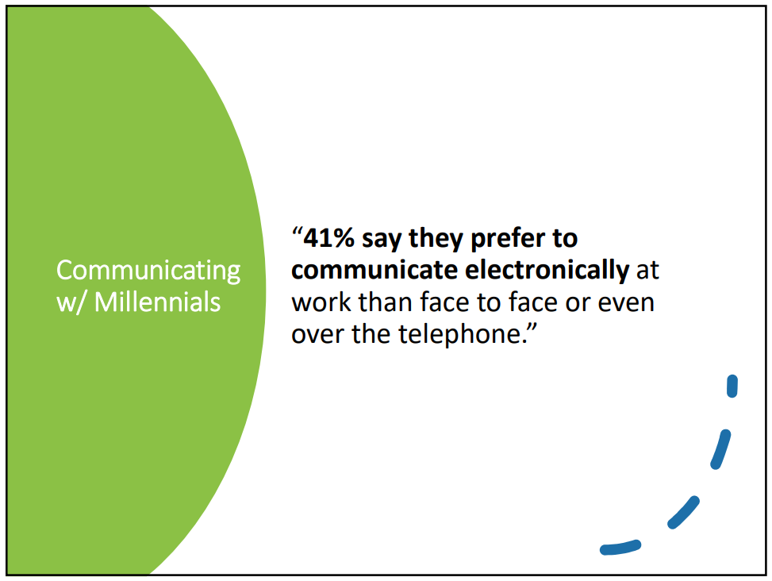

Slide 15
MARKETING TO YOUNGER MEMBERS
HAVE MULTIPLE WAYS TO JOIN:
PayPal, Credit Card, Bank Draft, Dues Deduction
Use Twitter, Instagram or Facebook
Use text or email to communicate Social Media and Website
Use storytelling testimonial as to why you joined
Make your own videos to show on website or YouTube
Use pictures or video of members volunteering at an event having fun
3 | Communication

Slide 16
RETAINING YOUNGER MEMBERS
Listen to their ideas and don’t be afraid to try something new at your meetings. Location of meeting is important. Have fewer meetings per year and be creative with location. Meeting start and finish time is critical. Lengthy meetings are NOT appealing. Meeting must be less than 2 hours and they want to learn something, have fun and leave. They socialize via email.
RECOGNITION is very important
Once a quarter host event where family can come or in a unique place
Have joint meetings with other chapters
Plan a trip to an attraction for a meeting
Remember birthdays, life events, and send Thank You cards/emails to show you care
IT HAS TO BE FUN OR THEY WON’T COME BACK
3 | Communication
Notes:
Meeting doesn’t have to always be a luncheon. Museums, historical sites, Happy Hour with the guest speaker visiting with the crowd instead of making a speech.
Invite local celebrities, sports/business leaders/CEOs/head of charities and foundations to attend.

Slide 17
HOW TO GROW YOUR LOCAL CHAPTERS
EFFECTIVE LEADERSHIP and DIVERSITY IS NEEDED:
Corporate Sponsorship - utilize hospitals, restaurants, banks, car dealerships for sponsorship and meeting room
Elevator Speech - 10 Second & 10 Minutes Rule must have - practice
Offer corporate sponsors 1year free membership, advertising on your chapter web site or newsletter, ask them to speak at your meeting.
1st and 2nd meetings are critical for retention-they will not come back if you don’t make them feel welcome
Brand Your Organization - wear your colors in hats, shirts, banners
Volunteer in community events and wear your colors
Offer 1st year free for new member
Story Telling sells
Facebook, YouTube videos are important
Visit HR Department in state and local government agencies and get membership info into the hands of the new retirees
Have interaction on social media
Create an association foundation and have scholarships for active and retired members
3 | Communication
Notes:
From your association HQ ask for the list of At-Large members from your county with contact information so your Local Chapter can contact them to let them know what all you do for the community and legislation they may be interested in. The Membership Committee should send them an email message before your next meeting to invite them, especially if you meeting is at a unique place or business like a car dealership who is a sponsor of your chapter. Bus trips for your members to local sites has been successful in many states. At your next meeting or via email have your members complete an interest survey so your leadership and see where the groups interest and hobbies lie and plan meetings and trips around the site. (Car dealerships, banks, credit unions, large new businesses in your community, sporting arenas, historical sites, product farms, crafts, etc.) Create your own 2 minute elevator speech on why someone should join your local association and practice it before your group. At the visitors 1st meeting, assign someone to sit with them and explain what your Local unit does for the community. Never leave the new member sitting by himself. Introduce him to the group and especially members who share his interests. The first meeting is the most important. If you don’t pay him attention and make it fun and interesting, he will not come back. Send him a welcome note the week after the meeting and invite him to the next one and ask him what he liked best about the experience.
You never have a 2nd chance to make a Good Impression. Put names of new members in your newsletters and weekly email news. Wear name tags at your meetings with your Association shirt and logo. Assign a member to the new visitor/member and never leave him alone by himself. Consider the 1st year free if will join that day. Hold joint meetings with other chapters, especially when you have a famous speaker, at a fun location, or at your local business partners location. Make your business sponsor a member of your association and put pictures on your website when your meetings are at their location. It is a WIN WIN for all. Have door prizes at your meetings and get corporate sponsors to contribute. Offer a discount if a couple joins your Local unit. Work on getting Business sponsors. Obtaining a local business sponsor is key. It is a WIN WIN for all.
Partner or Combine with another Local Chapters permanently or for 1 or 2 meetings a year. Instead of having monthly meetings, have a meeting each quarter and make it a unique, fun, interesting experience. Committee Chairs from both chapters will work with their committees to carry out the business of their chapters through their chapter newsletters or email. Consider having both women and men leaders and vary their ages and ethnic group also. Celebrate various ethnic groups holidays or festivals. Have a drawing for names of new members what joined that day, and a drawing for the member who brought a new member that day. Give away a $50 VISA card or other prize to encourage members to bring potential members to the meetings.
Invite to your meetings speaker who are local leaders in business, sports heroes, state agencies leaders, politicians in community, or organizations and business that effect your members. Examples of speakers to discuss: Hospitals/ambulance costs, Police to discuss safety tips of older citizens, Meals on Wheels, Animal Sheltor’s needs, Nursing home tips on selecting a facility, Medical equipment and insurance, Social Security updates, Funeral Home/legal questions concerning Wills, Hospital to discuss disease prevention, and then the FUN THINGS like hike and bike trails, Beautiful places to visit in California, Travel in state and out. Have a local Travel Agency review top trips via bus, ship, and planes for your group. Group travel is FUN.
From the state agency that you worked, as a former employee take to the HR Director there a poster about GSRA and newsletters to give to retiring employees to help grow membership. To get public recognition for GSRA and your local Chapter to show you work to support your community, volunteer to help other groups in your community like the Lions Club, Daughters of the American Revolution, Men and Women’s Clubs, Jr. League, Masonic Lodge, Rotary, Businessmen’s Bible Class etc.. Wear your GSRA shirt to let them know you support their efforts and cause and volunteer to hand out at their programs, be a greeter at the door, help at the concession stand.

Slide 18
HOW TO GROW YOUR LOCAL CHAPTERS
Alternatives to “Meetings”
Book or Movie Club
Tailgate or Watch parties
Painting Party
Game or Movie Night
Monthly Meal Prep
Organize group travel (local or afar)
3 | Communication

Slide 19
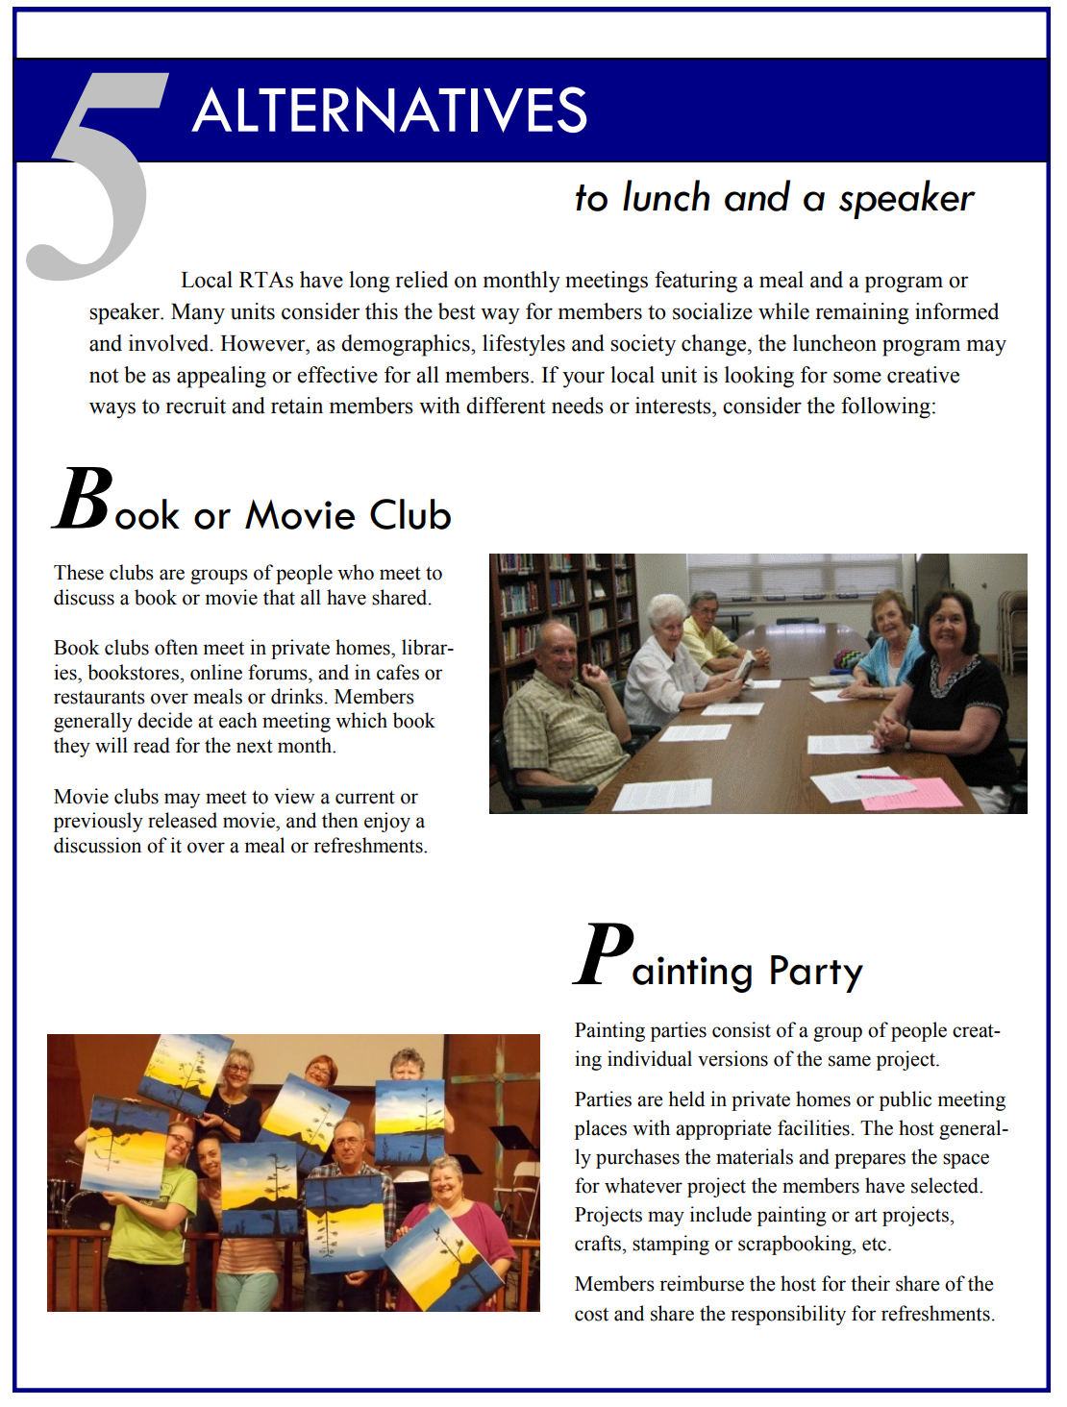

Slide 20
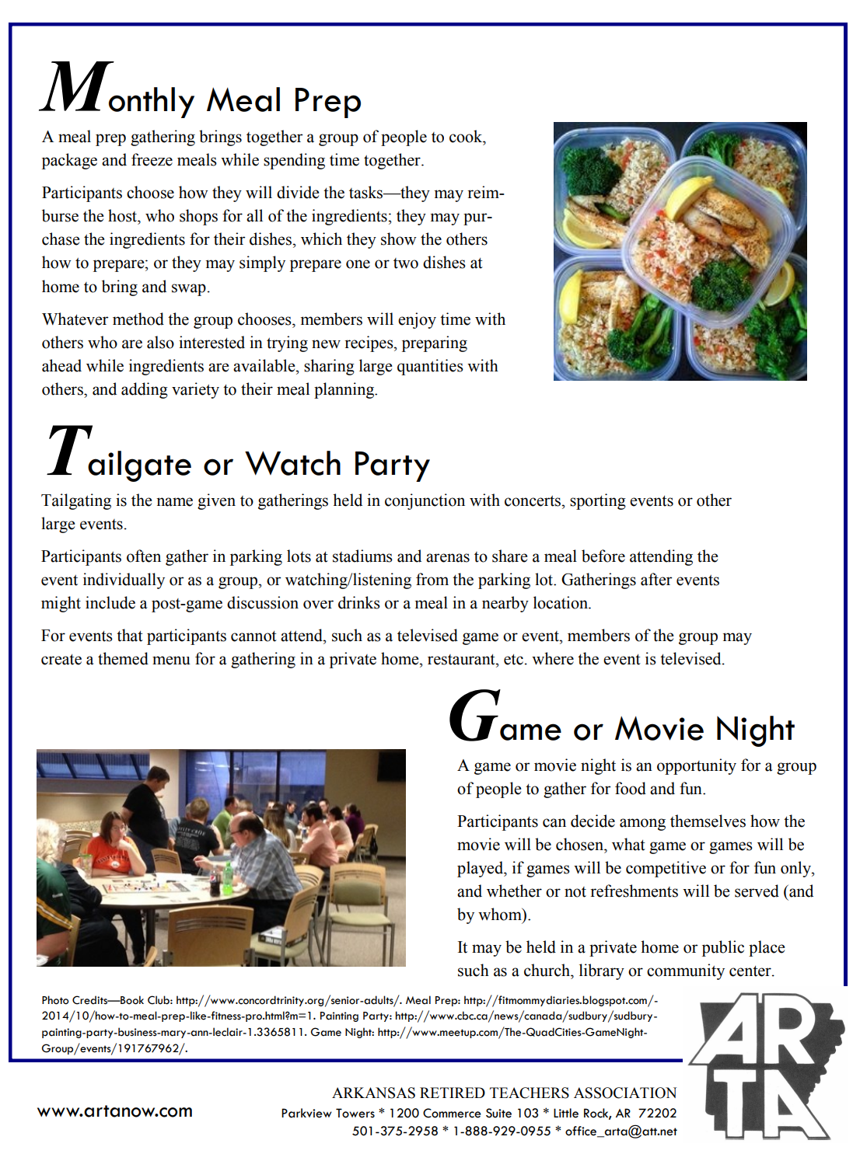

Slide 21
HOW TO GROW YOUR LOCAL CHAPTERS
Lessons Learned from the pandemic
Baby Boomers can use technology to connect and communicate
Emails are important to collect for connectivity
Shopping went online including prescriptions,
groceries, and home goods
Unit Facebook pages are more important to promote events and unit participation
Professional Zoom accounts can connect members
Board Meetings
Annual State Meetings
Social Events
Training
Local units can join together for an event to boost participation
Educational Webinars keep remote members connected
3 | Communication
Notes:
You never have a 2nd chance to make a Good Impression. Put names of new members in your newsletters and weekly email news. Wear name tags at your meetings and your Association shirt and logo. Assign a member to the new visitor/member and never leave him alone by himself. Consider the 1st year free if will join that day. Hold joint meetings with other units, especially when you have a famous speaker and at a large unit sponsor’s business. Make your business sponsor a member of your association and put pictures on your website when your meetings are at their location. It is a WIN WIN for all. Have door prizes at your meetings and get corporate sponsors to contribute. Offer a discount if a couple joins your Local unit. Work on getting Business sponsors.
Partner with other Local Units. All officers shouldn’t be one sex, have both women and men leaders and vary their ages and ethnic group also. Good ideas from All. Have a drawing for names in a bowl of new members what joined that day, and a drawing for member who brought a new member that day. Give away a
$50 VISA card or other card to encourage members to bring potential members to the meetings.

Slide 22
Officer Recruitment
How to get Officers for your local chapter:
Free memberships
Co-Officers
Grow your Own
Local Unit Support Team
3 | Communication
Notes:
Offer a FREE membership to officers and pay for their mileage and hotel room for out of town trips on association business. Have Co-Officers with 1 leader 1st year and the 2nd leader the 2nd year with both taking turns running the meetings. Have a Local Unit Support Team (LUST) that helps train and provide past experiences and knowledge of how events went in the past. Invite officers from other Local Units to meeting with new officers of your group to help with planning the years events. Training and mentoring for at least one month after taking their new position is always needed from previous leaders with timelines and a TO DO and DON’T DO List.

Slide 23
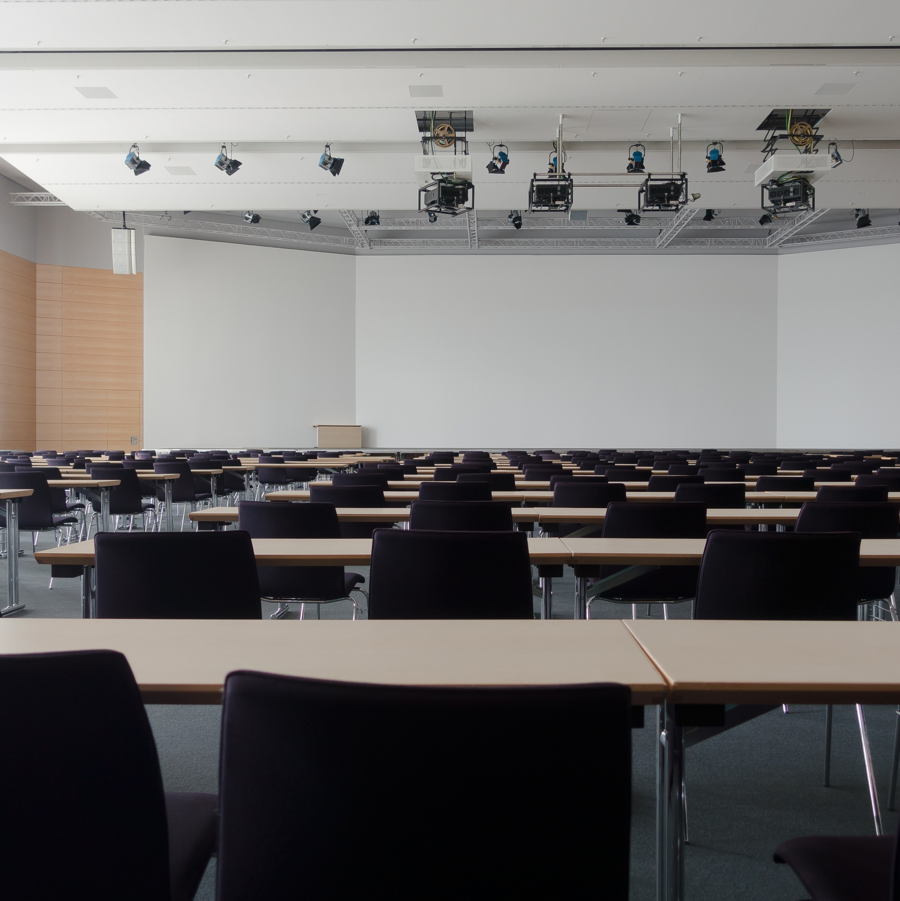
State Conventions
How do you get members to attend?
Session Topics
Money
Location
3 | Communication
Notes:
Vary the hotel and location from year to year. Have zoom call so members who can’t travel can participate Have Local Units poll their membership and types of sessions and information they want to hear. Vary the number of days and length of sessions. Encourage car pools. Have at least one session on dancing, exercise, movement of some type. Have a fitness instructor come for chair exercises. Be mindful of hotel costs and mileage. Small group sessions with interesting speakers on travel, local historic sites, must see places in the town, and famous/interesting people who live there are most often requested. Look for large corporate sponsors to help with the cost and charge vendors for exhibit tables at the meeting.

Slide 24
#5. Community
Foundations
PACs
Coalitions
4 | Community
Notes:
Community Foundations that can help retired state employees in need would be requested. Large philanthropic organizations in your state can always help.
Your Local Unit can help with a charitable cause in your community and members can wear their Chapter shirt and cap with your logo to let citizen know you do work to help your community. PACS with other state employee groups like police, fire, emergency personnel, hospitals, water and electrical power entities are needed. Coalitions with organizations in other states are helpful with national problems. When you volunteer for work with any of these entities, always wear your Local Units shirt and hat for recognition. Post pictures of your actions on your website so all know. TOOT YOUR OWN HORN!

Slide 25
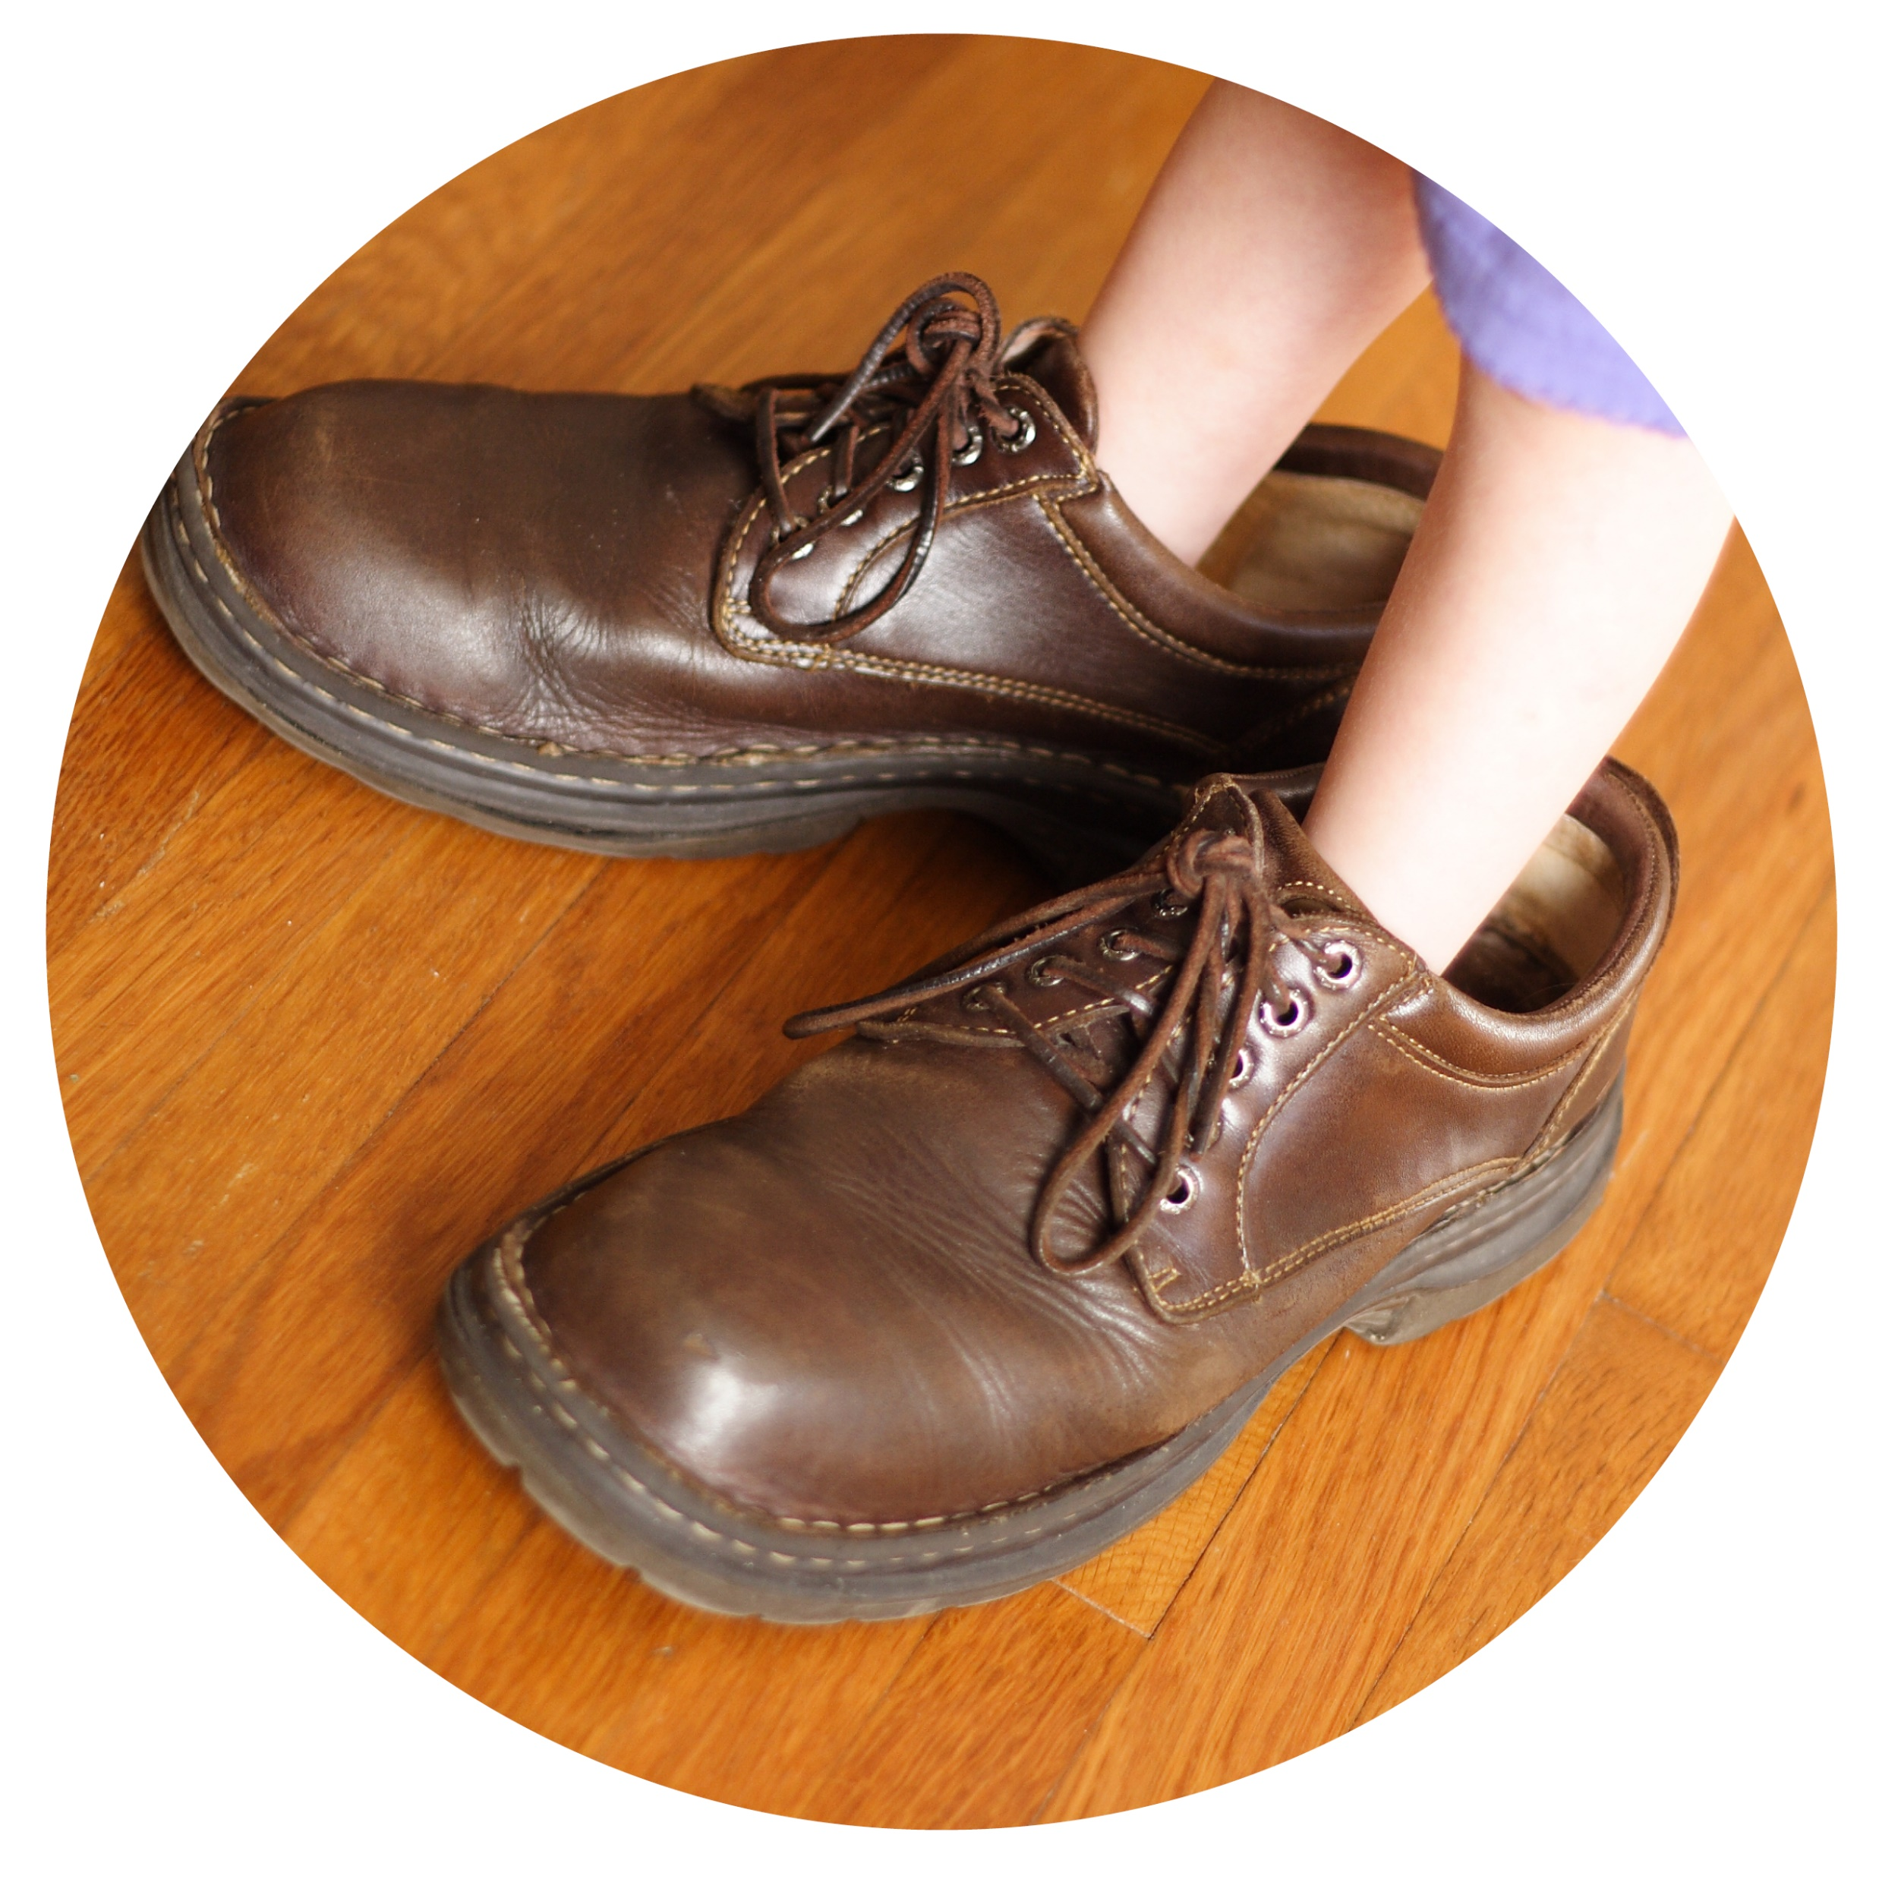
In conclusion
Through the 4C’s of Change, Concerns, Communication, and Community, your association can evaluate and learn from the efforts of others the best practices that can be utilized.
These best practices can help you in the next 20 years to recruit and retain membership.
Remember:
Who’s going to fill your shoes?
18

